Slide 1
COMP4901K/Math4824B Machine Learning for Natural Language Processing
Lecture 19: Featurized and Neural Language Models
Instructor: Yangqiu Song
Slides credits: Piotr Mirowski, Noah Smith, Dan Roth, and Chris Manning

Slide 2
Recap: what is a statistical LM?
A model specifying probability distribution over word sequences
p(“Today is Wednesday”) ≈ 0.001
p(“Today Wednesday is”) ≈ 0.0000000000001
p(“The eigenvalue is positive”) ≈ 0.00001
It can be regarded as a probabilistic mechanism for “generating” text, thus also called a “generative” model

Slide 3
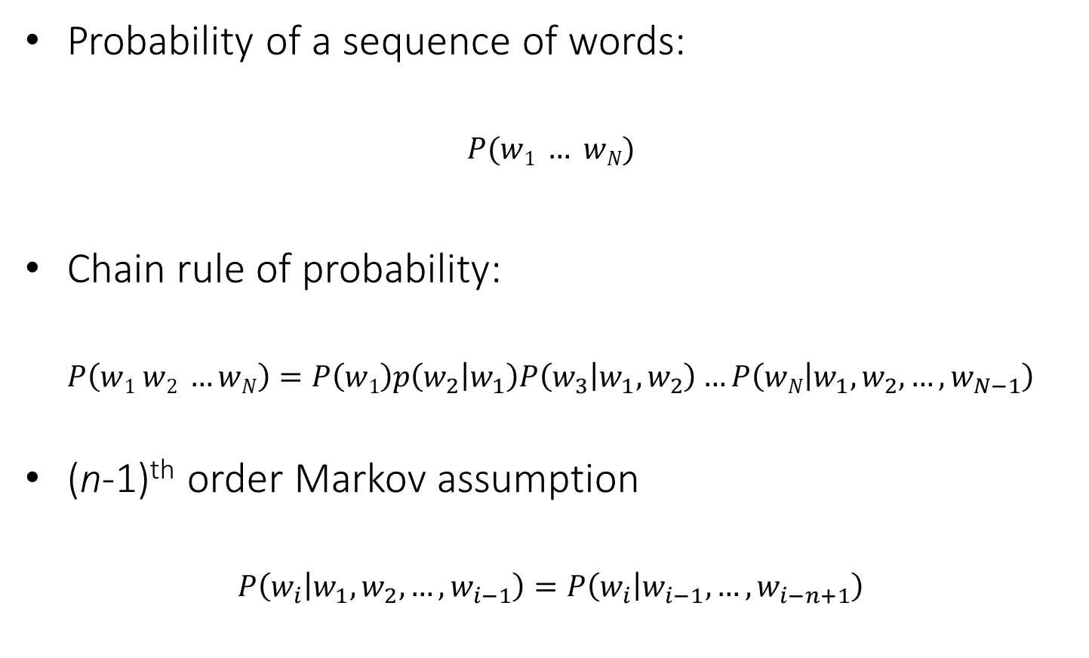
Probabilistic Language Models
Probability of a sequence of words:
$$P(w1 … wN)$$
Chain rule of probability:
$$P\left(w1 w2 …wN\right)=P\left(w1\right)p\left(w_{2} | w_{1}\right)P\left(w_{3} | w_{1},w_{2}\right)…P\left(wN | w_{1},w_{2},…,w_{N−1}\right)$$
(n-1)^{th} order Markov assumption
$$P\left(w_{i} | w_{1},w_{2},…,w_{i−1}\right)=P\left(w_{i} | w_{i−1},…,w_{i−n+1}\right)$$

Slide 4
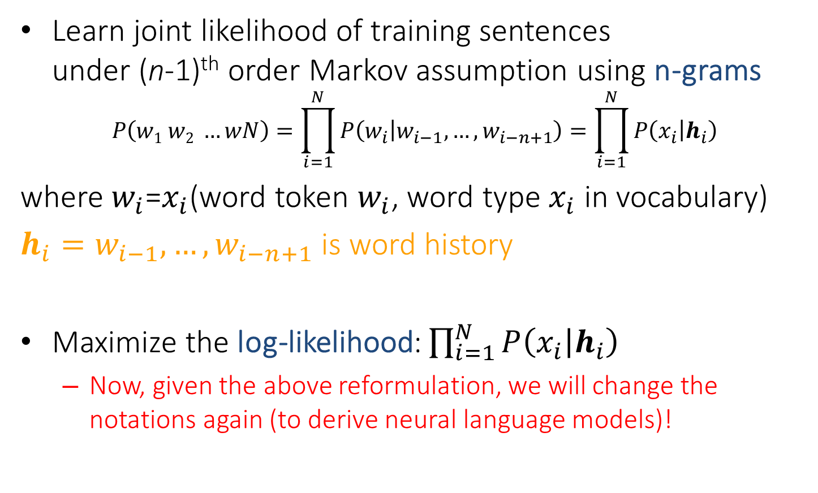
Learning probabilistic language models
Learn joint likelihood of training sentences under (n-1)^{th} order Markov assumption using n-grams
$$P\left(w1 w2 …wN\right)=\prod_{i=1}^{N}{P\left(w_{i} | w_{i−1},…,w_{i−n+1}\right)}=\prod_{i=1}^{N}{P\left(x_{i} | h_{i}\right)}$$
where $w_{i}$=$x_{i}$(word token $w_{i}$, word type $x_{i}$ in vocabulary)
$h_{i}=w_{i−1},…,w_{i−n+1}$ is word history
Maximize the log-likelihood: $\prod_{i=1}^{N}{P\left(x_{i} | h_{i}\right)}$
Now, given the above reformulation, we will change the notations again (to derive neural language models)!

Slide 5
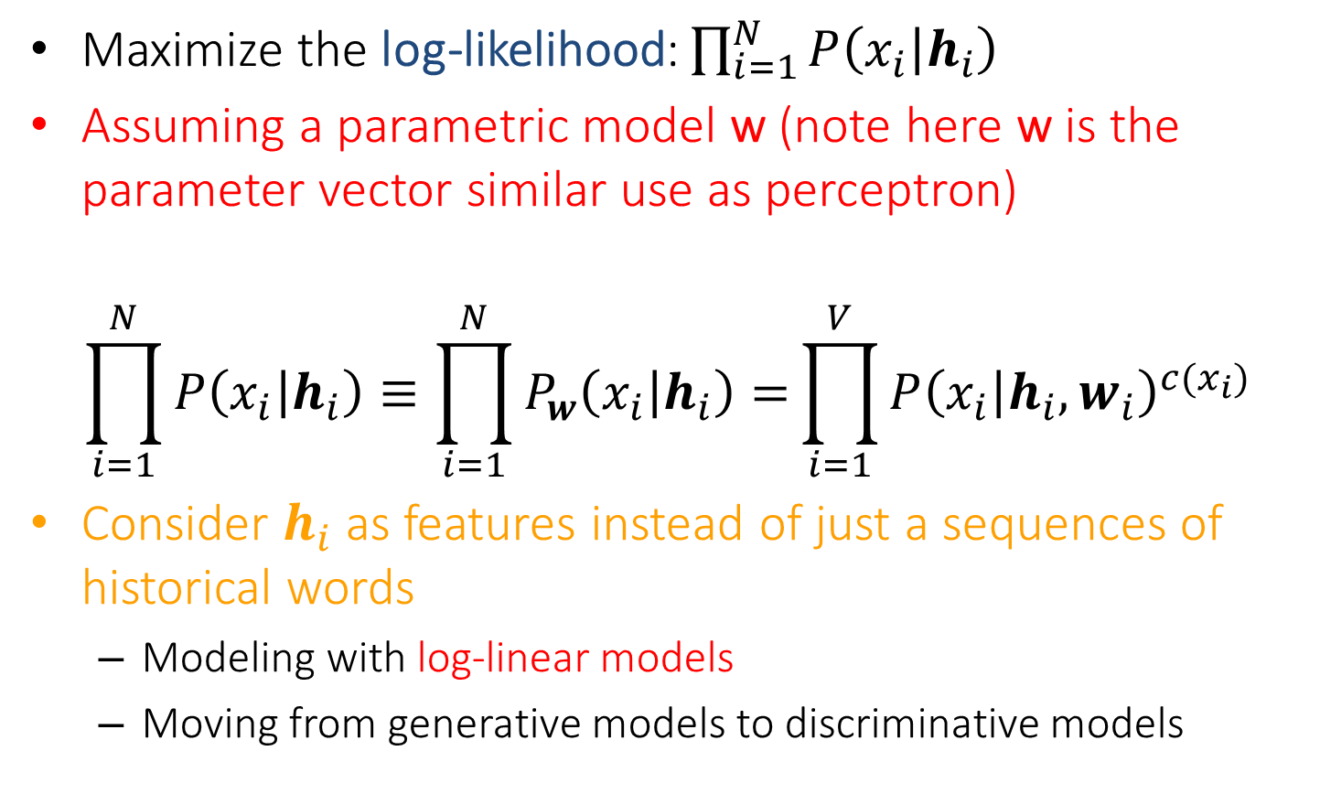
Featurized Language Models: Re-parameteriazation
Maximize the log-likelihood: $\prod_{i=1}^{N}{P\left(x_{i} | h_{i}\right)}$
Assuming a parametric model w (note here w is the parameter vector similar use as perceptron)
$$\prod_{i=1}^{N}{P\left(x_{i} | h_{i}\right)≡\prod_{i=1}^{N}{P_{w}\left(x_{i} | h_{i}\right)}=}\prod_{i=1}^{V}{P{\left(x_{i} | h_{i},w_{i}\right)}^{c(x_{i})}}$$
Consider $h_{i}$ as features instead of just a sequences of historical words
Modeling with log-linear models
Moving from generative models to discriminative models

Slide 6
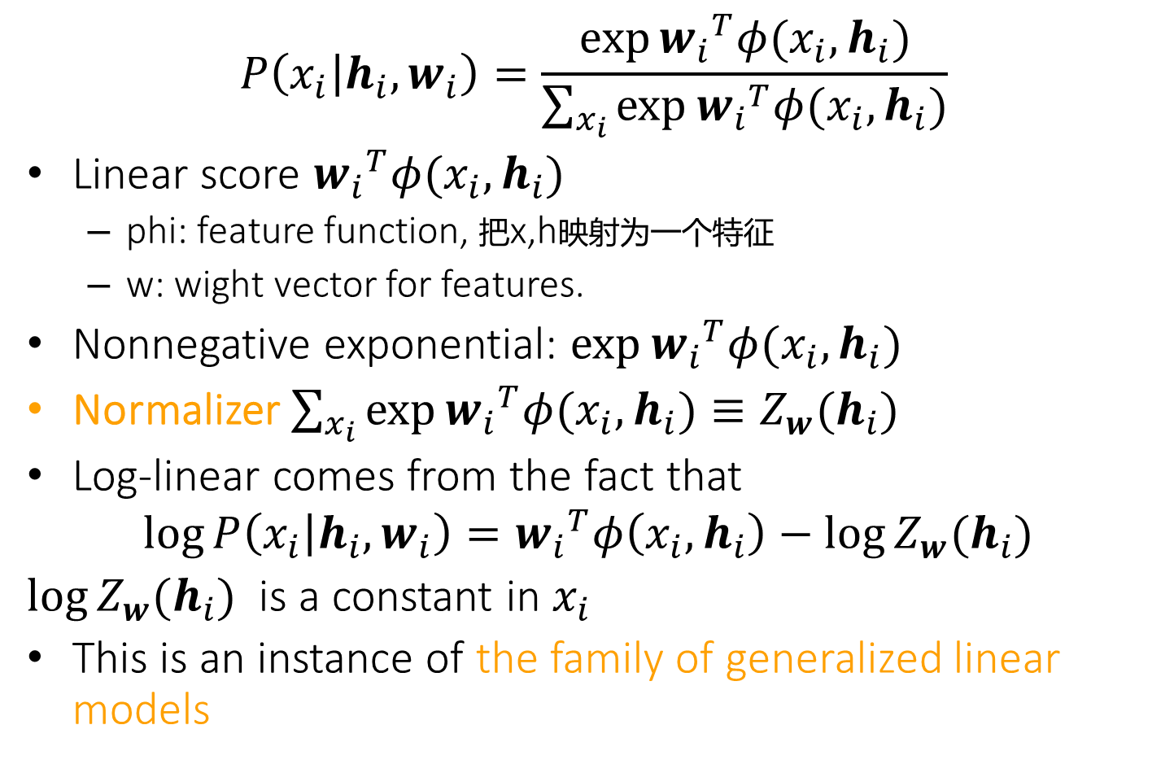
Log-linear Models
$$P\left(x_{i} | h_{i},w_{i}\right)=\frac{\exp{{w_{i}}^{T}φ(x_{i},h_{i})}}{\sum_{x_{i}}{\exp{{w_{i}}^{T}φ(x_{i},h_{i})}}}$$
Linear score ${w_{i}}^{T}φ(x_{i},h_{i})$
phi: feature function, 把x,h映射为一个特征
w: wight vector for features.
Nonnegative exponential: $\exp{{w_{i}}^{T}φ(x_{i},h_{i})}$
Normalizer $\sum_{x_{i}}{\exp{{w_{i}}^{T}φ(x_{i},h_{i})}}≡Z_{w}(h_{i})$
Log-linear comes from the fact that
$$\log{P\left(x_{i} | h_{i},w_{i}\right)}={w_{i}}^{T}φ\left(x_{i},h_{i}\right)−\log{Z_{w}(h_{i}) }$$
$\log{Z_{w}(h_{i}) }$ is a constant in $x_{i}$
This is an instance of the family of generalized linear models

Slide 7
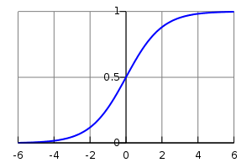
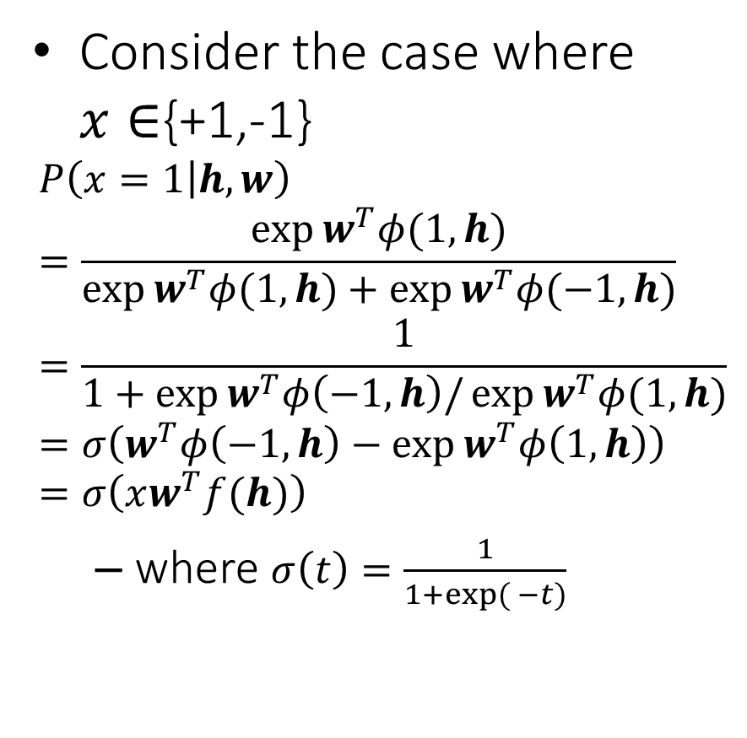
Special Case: Logistic Regression
Consider the case where $x∈${+1,-1}
$$P\left(x=1 | h,w\right)=\frac{\exp{w^{T}φ(1,h)}}{\exp{w^{T}φ(1,h)}+\exp{w^{T}φ(−1,h)}}=\frac{1}{1+\exp{w^{T}φ\left(−1,h\right)/\exp{w^{T}φ(1,h)}}}=σ\left(w^{T}φ\left(−1,h\right)−\exp{w^{T}φ\left(1,h\right)}\right)=σ\left(xw^{T}f(h)\right)$$
where $σ\left(t\right)=\frac{1}{1+exp({−t)}}$
log-linear models are often called multinomial logistic regression (softmax function)

Slide 8
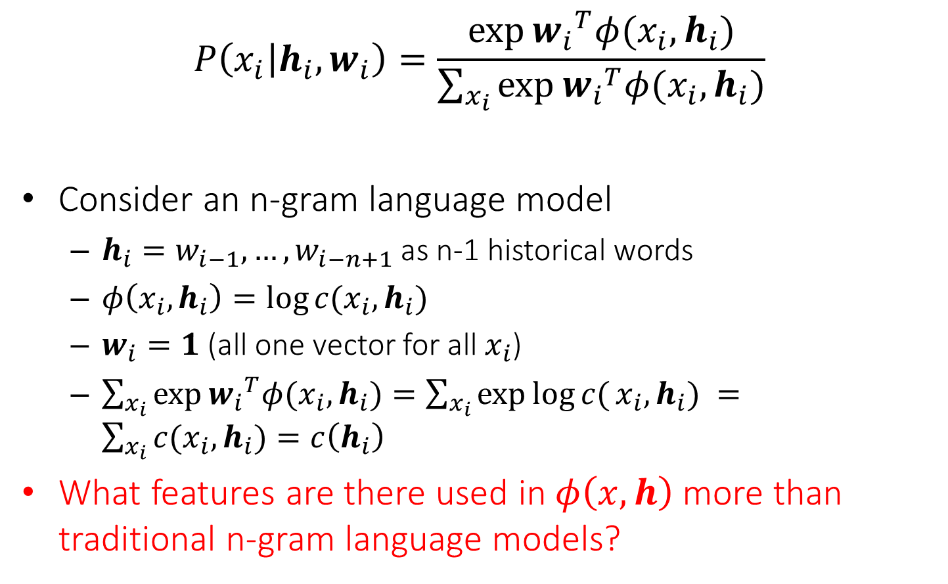
Special Case: N-gram Language Model
$$P\left(x_{i} | h_{i},w_{i}\right)=\frac{\exp{{w_{i}}^{T}φ(x_{i},h_{i})}}{\sum_{x_{i}}{\exp{{w_{i}}^{T}φ(x_{i},h_{i})}}}$$
Consider an n-gram language model
$h_{i}=w_{i−1},…,w_{i−n+1}$ as n-1 historical words
$φ\left(x_{i},h_{i}\right)=\log{c(x_{i},h_{i}) }$
$w_{i}=1$ (all one vector for all $x_{i}$)
$\sum_{x_{i}}{\exp{{w_{i}}^{T}φ(x_{i},h_{i})}}=\sum_{x_{i}}{\exp{\log{c(}x_{i},h_{i}) }}=\sum_{x_{i}}{c(x_{i},h_{i})}=c\left(h_{i}\right)$
What features are there used in $φ\left(x,h\right)$ more than traditional n-gram language models?

Slide 9
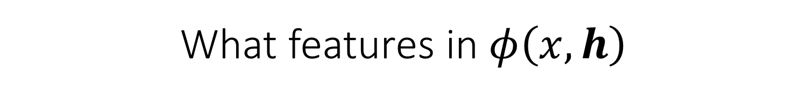
What features in $φ\left(x,h\right)$
Traditional n-gram features: last ^ Saturday
“Gappy” n-gram features: Central ^ Saturday
Spelling features: first character is capitalized
Class features: whether it is a member of class 132
Gazetteer features: whether it is listed as a geographic place name,date/time, person name, organization name, etc.

Slide 10
What features in $φ\left(x,h\right)$
You can define any features you want!
Too many features, and your model will overt
“Feature selection” methods, e.g., ignoring features with very low counts, can help
Too few (good) features, and your model will not learn

Slide 11
Parameter Estimation
Gradient descent!
no closed form as traditional n-gram language models
Further Reading
Berger et al. (1996).A Maximum Entropy Approach to Natural Language Processing.
Collins (2011). Course notes for COMS w4705: Log-linear models, MEMMs, and CRFs, 2011.
http://www.cs.columbia.edu/~mcollins/crf.pdf
Smith (2004). Log-linear models, 2004.
https://homes.cs.washington.edu/~nasmith/papers/smith.tut04.pdf

Slide 12
Extension: Neural Language Models
Feedforward Neural Network Language Model Bengio et al. (2003)
A generalization of featurized language model
Word embeddings can be learnt!

Slide 13
Feedforward Neural Network Language Model Bengio et al. (2003)

Slide 14
Results

Slide 15
Important Idea: Words as Vectors
The idea of “embedding” words much older than neural language models.
Deerwester et al. (1990) explored dimensionality reduction techniques for information retrieval-style querying of text collections
We will come back to this topic
Indexing by latent semantic analysis (1990) by Scott Deerwester , Susan T. Dumais , George W. Furnas , Thomas K. Landauer , Richard Harshman

Slide 16
Parameter Estimation
Good news:
The whole computation is differentiable with respect to parameters, so gradient-based methods are available
Lots more details in Bengio et al. (2003)
Bad news for neural language models (in 2003):
Calculating log-likelihood and its gradient is very expensive (5 epochs took 3 weeks on 40 CPUs, in Bengio et al. (2003))
Yoshua Bengio, Réjean Ducharme, Pascal Vincent, and Christian Janvin. 2003. A neural probabilistic language model. J. Mach. Learn. Res. 3 (March 2003), 1137-1155.

Slide 17
Observations about Neural Language Models (So Far)
There's no knowledge built in that the most recent word should generally be more informative than earlier ones
This has to be learned
In addition to choosing (n-1)gram historical words, also have to choose dimensionalities like d and H
Parameters of these models are hard to interpret
Individual word embeddings can be clustered and dimensions can be analyzed (e.g., Tsvetkov et al. (2015))
Still, impressive perplexity gains got people's interest

Slide 18
Recurrent Neural Networks
General ideas
Can we use more historical words?
Can parameters be shared?

Slide 19
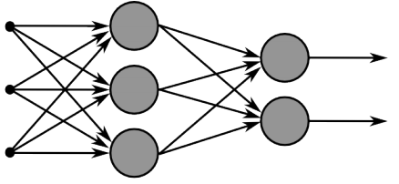
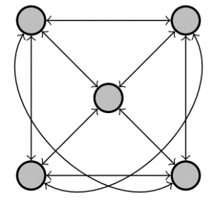
Recurrent Neural Networks
Multi-layer feed-forward NN: DAG
Just computes a fixed sequence of
non-linear learned transformations to convert an input pattern into an output pattern
Recurrent Neural Network: Digraph
Has cycles.
Cycle can act as a memory;
The hidden state of a recurrent net can carry along information about a “potentially” unbounded number of previous inputs.
They can model sequential data in a much more natural way.

Slide 20
Equivalence between RNN and Feed-forward NN
Assume that there is a time delay of 1 in using each connection.
The recurrent net is just a layered net that keeps reusing the same weights.
time=3
W1 W2 W3 W4
w1 w4
time=2
W1 W2 W3 W4
w2 w3
time=1
W1 W2 W3 W4
time=0

Slide 21
Recurrent Neural Networks
Training a general RNN’s can be hard
Here we will focus on a special family of RNN’s
Prediction on chain-like input:
Language model
POS tagging words of a sentence
Sentiment classification
$X,h=$ This is a sample sentence .
Y$=$ is a sample sentence . <EOS>
$X=$ This is a sample sentence .
Y$=$ DT VBZ DT NN NN .
$X=$ This is a sample sentence .
Y$=$ Positive/Negative

Slide 22
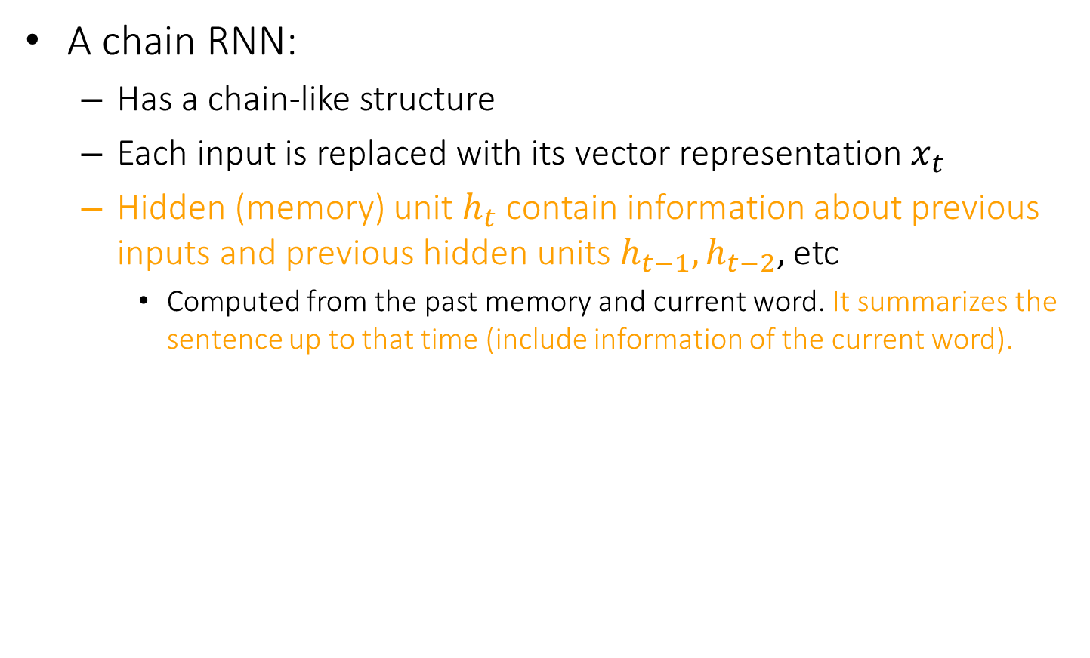
Recurrent Neural Networks
A chain RNN:
Has a chain-like structure
Each input is replaced with its vector representation $x_{t}$
Hidden (memory) unit $h_{t}$ contain information about previous inputs and previous hidden units $h_{t−1},h_{t−2},$ etc
Computed from the past memory and current word. It summarizes the sentence up to that time (include information of the current word).
$x_{t−1}$ $x_{t}$ $x_{t+1}$
O O O O O
O O O O O
O O O O O
Input layer
O O O O O
O O O O O
O O O O O
Memory layer
$h_{t−1}$ $h_{t}$ $h_{t+1}$

Slide 23

Recurrent Neural Networks
A popular way of formalizing it:
$$h_{t}=f(W_{h}h_{t−1}+W_{i}x_{t})$$
Where $f$ is a nonlinear, differentiable (why?) function.
Outputs?
Many options; depending on problem and computational resource
$x_{t−1}$ $x_{t}$ $x_{t+1}$
O O O O O
O O O O O
O O O O O
O O O O O
O O O O O
O O O O O
$h_{t−1}$ $h_{t}$ $h_{t+1}$

Slide 24
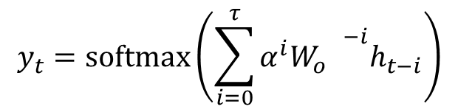



Recurrent Neural Networks
Prediction for $x_{t}$, with $h_{t}$
Prediction for $x_{t}$, with $h_{t},{…, h}_{t−τ}$
Prediction for the whole chain
$$y_{t}=softmax\left(W_{o}h_{t} \right)$$
$$y_{t}=softmax\left(\sum_{i=0}^{τ}{α^{i}{W_{o}^{}}^{−i}h_{t−i}}\right)$$
$$y_{T}=softmax\left(W_{o}h_{T} \right)$$
$x_{t−1}$ $x_{t}$ $x_{t+1}$
O O O O O
O O O O O
O O O O O
O O O O O
O O O O O
O O O O O
$h_{t−1}$ $h_{t}$ $h_{t+1}$
$y_{t−1}$ $y_{t}$ $y_{t+1}$

Slide 25
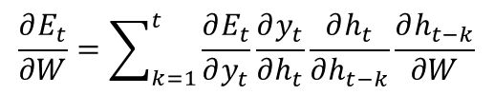


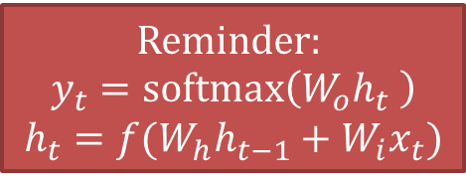
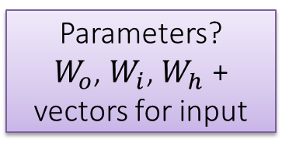
Training RNNs
How to train such model?
Generalize the same ideas from back-propagation
Total output error: $E\left(\vec{y}, \vec{t}\right)=\sum_{t=1}^{T}{E_{t}\left(y_{t}{, t}_{t}\right)}$
Reminder:
$$y_{t}=softmax\left(W_{o}h_{t} \right)$$
$$h_{t}=f(W_{h}h_{t−1}+W_{i}x_{t})$$
Parameters?
$W_{o}$, $W_{i}$, $W_{h}$ +
vectors for input
$$\frac{∂E}{∂W}=\sum_{t=1}^{T}{\frac{∂E_{t}}{∂W}}$$
$$\frac{∂E_{t}}{∂W}=\sum_{k=1}^{t}{\frac{∂E_{t}}{∂y_{t}}\frac{∂y_{t}}{∂h_{t}}\frac{∂h_{t}}{∂h_{t−k}}\frac{∂h_{t−k}}{∂W}}$$
This sometimes is called “ Backpropagation Through Time ”, since the gradients are propagated back through time.
$x_{t−1}$ $x_{t}$ $x_{t+1}$
O O O O O
O O O O O
O O O O O
O O O O O
O O O O O
O O O O O
$h_{t−1}$ $h_{t}$ $h_{t+1}$
$y_{t−1}$ $y_{t}$ $y_{t+1}$
Backpropagation for RNN

Slide 26
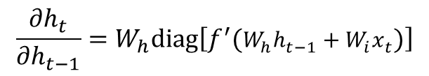
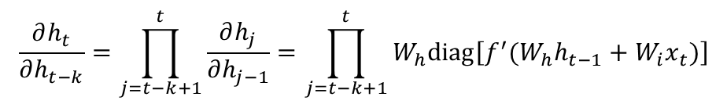
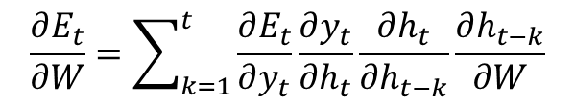
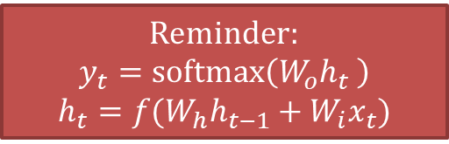

Recurrent Neural Network
Reminder:
$$y_{t}=softmax\left(W_{o}h_{t} \right)$$
$$h_{t}=f(W_{h}h_{t−1}+W_{i}x_{t})$$
$$\frac{∂E_{t}}{∂W}=\sum_{k=1}^{t}{\frac{∂E_{t}}{∂y_{t}}\frac{∂y_{t}}{∂h_{t}}\frac{∂h_{t}}{∂h_{t−k}}\frac{∂h_{t−k}}{∂W}}$$
$$diag\left[a_{1}, …, a_{n}\right]=\left[\begin{matrix}a_{1} & 0 & 0 \\ 0 & ⋱ & 0 \\ 0 & 0 & a_{n}\end{matrix}\right]$$
$$\frac{∂h_{t}}{∂h_{t−1}}=W_{h}diag\left[f^{′}(W_{h}h_{t−1}+W_{i}x_{t})\right]$$
$$\frac{∂h_{t}}{∂h_{t−k}}=\prod_{j=t−k+1}^{t}{\frac{∂h_{j}}{∂h_{j−1}}}=\prod_{j=t−k+1}^{t}{W_{h}diag\left[f^{′}(W_{h}h_{t−1}+W_{i}x_{t})\right]}$$
$x_{t−1}$ $x_{t}$ $x_{t+1}$
O O O O O
O O O O O
O O O O O
O O O O O
O O O O O
O O O O O
$h_{t−1}$ $h_{t}$ $h_{t+1}$
$y_{t−1}$ $y_{t}$ $y_{t+1}$

Slide 27
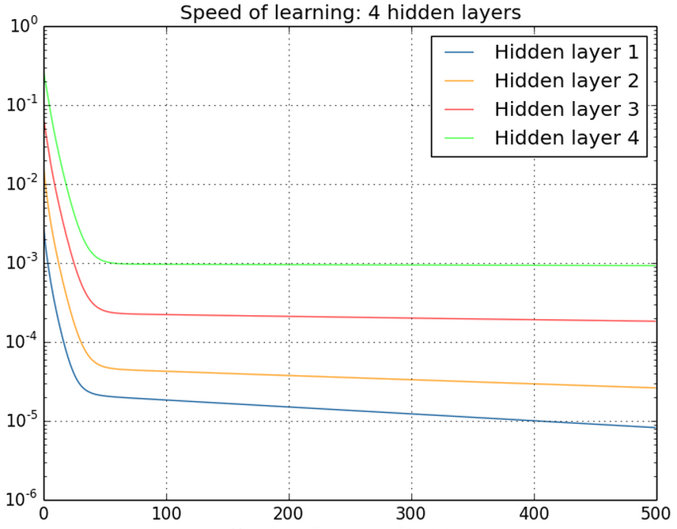
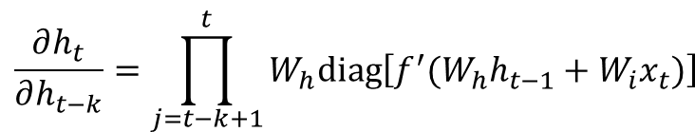
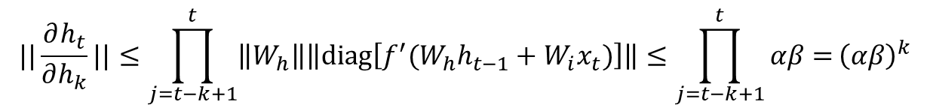
Vanishing/exploding gradients
$$\frac{∂h_{t}}{∂h_{t−k}}=\prod_{j=t−k+1}^{t}{W_{h}diag\left[f^{′}(W_{h}h_{t−1}+W_{i}x_{t})\right]}$$
Vanishing gradients are quite prevalent and a serious issue.
A real example
Training a feed-forward network
y-axis: sum of the gradient norms
Earlier layers have exponentially
smaller sum of gradient norms
This will make training earlier
layers much slower.
$$||\frac{∂h_{t}}{∂h_{k}}||≤\prod_{j=t−k+1}^{t}{\left\|W_{h}\right\|\left\|diag\left[f^{′}(W_{h}h_{t−1}+W_{i}x_{t})\right]\right\|≤\prod_{j=t−k+1}^{t}{αβ=}{\left(αβ\right)}^{k}}$$
Gradient can become very small or very large quickly, and the locality assumption of gradient descent breaks down (Vanishing gradient) [Bengio et al 1994]

Slide 28

Vanishing/exploding gradients
In an RNN trained on long sequences (e.g. 100 time steps) the gradients can easily explode or vanish.
So RNNs have difficulty dealing with long-range dependencies.
Many methods proposed for reduce the effect of vanishing gradients; although it is still a problem
Introduce shorter path between long connections
Abandon stochastic gradient descent in favor of a much more sophisticated Hessian-Free (HF) optimization
Add fancier modules that are robust to handling long memory; e.g. Long Short Term Memory (LSTM)
http://colah.github.io/posts/2015-08-Understanding-LSTMs/
A very good explanatiom of LSTM
One trick to handle the exploding-gradients:
Clip gradients with bigger sizes:
Define $g=\frac{∂E}{∂W}$
If $\left\|g\right\|≥threshold$ then
$g←\frac{threshold}{\left\|g\right\|}g$

Slide 29
Perplexity Results
KN5 = Count-based language model with Kneser-Ney smoothing & 5-grams
Table from paper Extensions of recurrent neural network language model by Mikolov et al 2011

Slide 30



Bi-directional RNN
One of the issues with RNN:
Hidden variables capture only one side context
A bi-directional structure
$x_{t−1}$ $x_{t}$ $x_{t+1}$
O O O O O
O O O O O
O O O O O
$$h_{t}=f(W_{h}h_{t−1}+W_{i}x_{t})$$
$h_{t−1}$ $h_{t}$ $h_{t+1}$
$${\tilde{h}}_{t}=f({\tilde{W}}_{h}{\tilde{h}}_{t+1}+{\tilde{W}}_{i}x_{t})$$
$$y_{t}=softmax\left(W_{o}h_{t}+{\tilde{W}}_{o}{\tilde{h}}_{t}\right)$$
O O O O O
O O O O O
O O O O O
O O O O O
O O O O O
O O O O O
${\tilde{h}}_{t−1}$ ${\tilde{h}}_{t}$ ${\tilde{h}}_{t+1}$
$y_{t−1}$ $y_{t}$ $y_{t+1}$

Slide 31
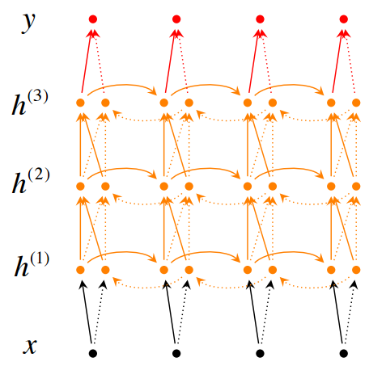
Stack of bi-directional networks
Use the same idea and make your model further complicated:

